Slide 1
Angular 5(Avengers)
CRUD

Slide 2
Setup and Configuration PC
Node
https://nodejs.org/en/
Angular CLI
https://cli.angular.io/
Typescript
https://www.typescriptlang.org/
Visual Studio Code
https://code.visualstudio.com/download

Slide 3
Node JS
Scripting side Run time environment

Slide 4
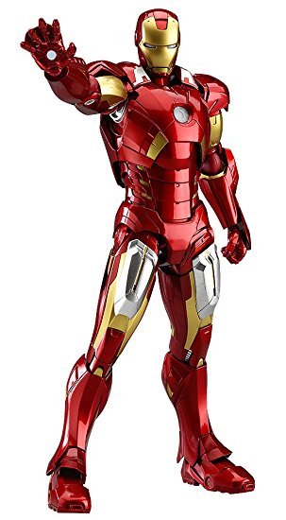

Why Node ?
Web APP
Dot net or Java or Ruby
jQuery
HTML
Styles
images
Web Requests
Browser
IIS or Web brick

Slide 5

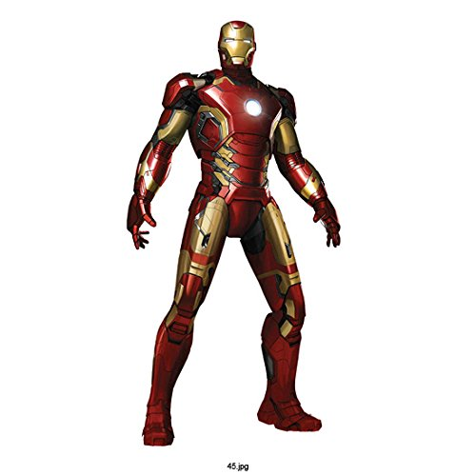
Standalone client Side
IIS or Web brick
Angular Framework
jQuery
HTML
Web Requests
Web API
Dot net or Java or Ruby
Styles
images
Server Side
Node
server
Browser

Slide 6

Angular CLI
Command Line interface

Slide 7

Supported Language
Typescript
ECMA script 5
Dart
Pure script
Elm etc..

Slide 8
Why Typescript ?
Angular itself is typescript
ECMA 6

Slide 9
Visual Studio Code
Open source
Powerful
Intellisence
Integrated GIT
Extension managers

Slide 10

Key advantages
Watch mode lite server
Fastest Rendering technique
5 times more performance
Improved Compiler
Wonderful developer and user experience
Mobile Support

Slide 11
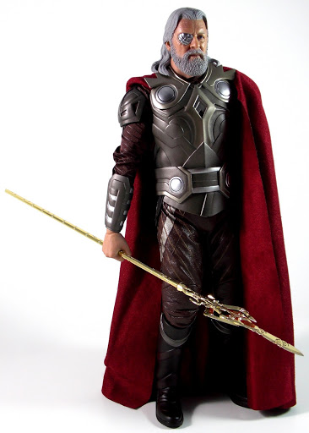
App component
Parent element
Parent element contain the basic theme like headers and footers
It Contain a place holder
<router-outlet>

Slide 12

Component
Components are the most basic UI building block of an Angular app
Angular components are a subset of directives, always associated with a template

Slide 13

Multi-components
Selectors
Html
CSS
Class
Methods

Slide 14

Route Module
Router enables navigation from one view to the next as users perform application tasks

Slide 15

Services
communicator between Client and Server
Calls the API and map the models

